Slide 1

Newborn Screening for Congenital Hypothyroidism – I
Indian Society for Pediatric and Adolescent Endocrinology (ISPAE) Module

Slide 2
Desai MP et al, Indian J Pediatr. 2018; 85:440-7
Sudhanshu S et al, Indian J Pediatr. 2018; 85:448-53

Slide 3
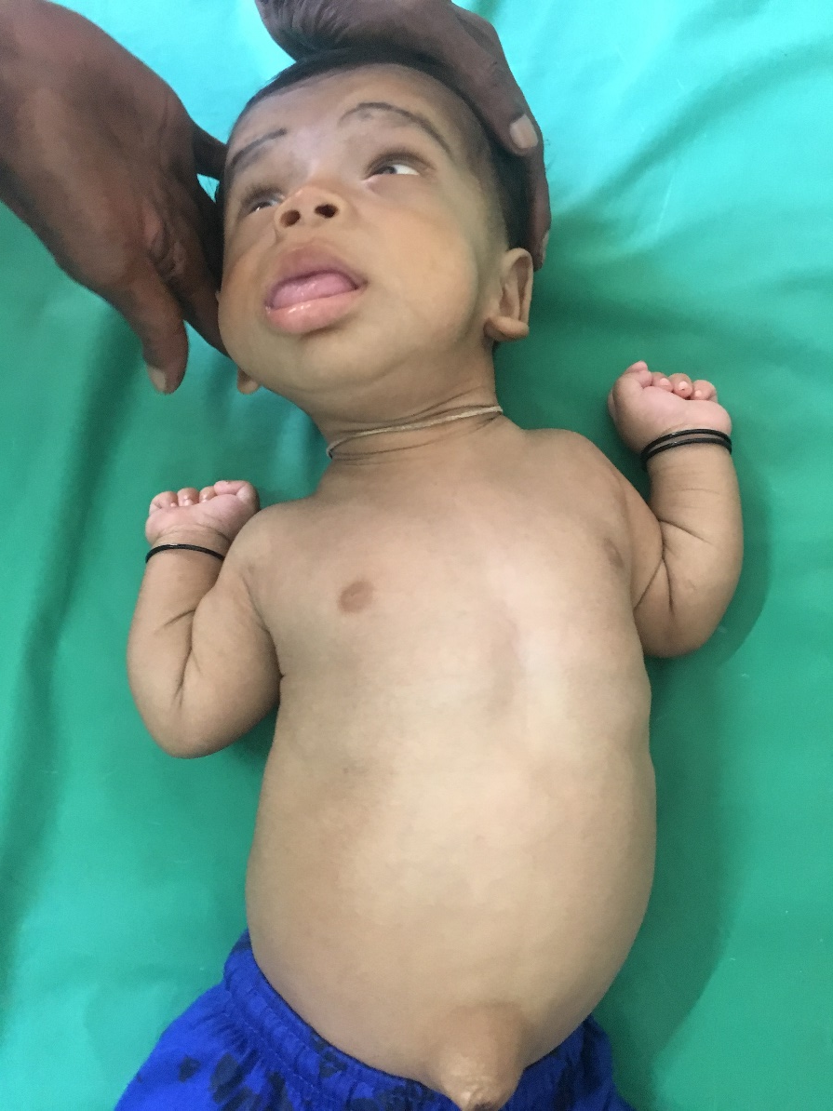
Case scenario
What is the diagnosis?

Slide 4
Your diagnosis is correct
This baby most likely has congenital hypothyroidism
Congratulations!!!
But it is too late !

Slide 5
Learning objectives
Importance of newborn screening for congenital hypothyroidism (CH)
Practical aspects of screening
  Which sample?
  Timing of the sample
  Test to be performed
Interpretation of screening and confirmatory tests
Evaluation, management and follow-up of children with CH

Slide 6
Introduction
Congenital hypothyroidism (CH) is the commonest cause of preventable intellectual disability
Less than 5% babies are symptomatic at birth and only up to 10% may show symptoms in the first month of life
Near-normal outcomes can be seen if CH is diagnosed and treated before 2 weeks of age, whereas delay in treatment causes permanent neurologic damage

Slide 7
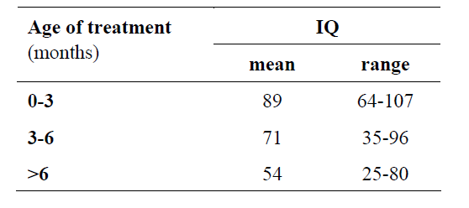
Inverse relationship between age at clinical diagnosis of CH and IQ outcome
Klein AH, Meitzer S, Kenny FM. J Pediatr 1972; 81: 912-5

Slide 8
Rationale for newborn screening of CH
Common disorder – more common in India than developed countries
  CH- 1 in 1000-1500^{1,2}
  Phenylketonuria- 1 in 10,000
  Classic CAH- 1 in 15,000
  Galactosemia- 1 in 60,000
Screening method (TSH) cheap and easily available
Highly effective and relatively inexpensive treatment
Benefit of treating at least 10 times more than the cost of screening³
¹ICMR Task Force on Inherited Metabolic Disorders. Indian J Pediatr. 2018; 85:935-40,
²Mathai S et al, Abstract presented at 8th Asia Pacific Regional Meeting of the International Society for Neonatal Screening. New Delhi, Sep 2013, ³Geelhoed EA, J Pediatr Child Health 2005; 41:575-9

Slide 9
Fetal and newborn thyroid physiology

Slide 10
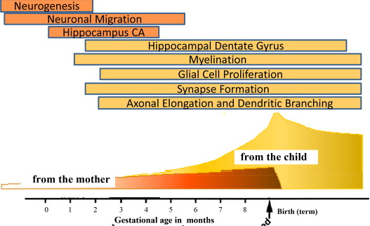
Thyroid physiology in fetus
Thyroid hormone important at all stages of neurologic development
In the 1st trimester, maternal thyroid hormones only source for fetus
Maternal thyroxine partially protects a hypothyroid infant in utero
Glibert ME et al, Neurotoxicology, 2012; 33:842-52

Slide 11
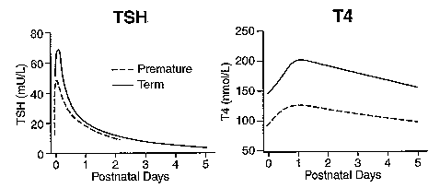
Neonatal thyroid physiology
Marked rise in TSH within 30 min after birth, peak at 24 hr, normalization over 2-5 days
Thought to be due to stress during labor and exposure to cold ambient hypothermia of extrauterine environment
Followed by rise in T4
Brook’s Clinical Pediatric Endocrinology, 6th Edition
Cord blood sample is not affected by the TSH surge
Postnatal samples collected before 48 hours can have high false positive rates

Slide 12
Practical aspects of sampling

Slide 13
Which sample should be collected?
Cord sample
  Easy to draw, no extra prick to the infant
  Suitable during early discharge of mothers
  Sample can be processed at any local laboratory
  Training required is minimal
  Other disorders cannot be screened
  Staff on all the shifts need to be trained
Postnatal heel prick (filter paper)
  Can be used to screen multiple disorders
  Only morning staff needs to be trained
  Can even be done for home deliveries
  Needs special assay and a reliable central lab
  Adequate training to ensure error free blood spots
Postnatal peripheral venous sample is acceptable if filter paper sample is not feasible

Slide 14
Timing of the sample
Either cord blood or postnatal sample at 48-72 hr (not later than 5 days) should be collected for screening
In case of early discharge of infants from nursery or need of blood transfusion, sample can be collected between 24-48 hr (cut-off values of TSH for recall are different for such samples)
Timing of first screening in preterm and SGA same as in term
For sick newborns in NICU, sample should be collected before 7 days of life or discharge from NICU whichever is earlier
No infant should be sent home without CH screening

Slide 15
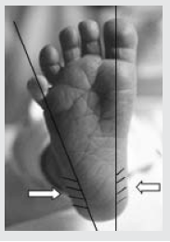
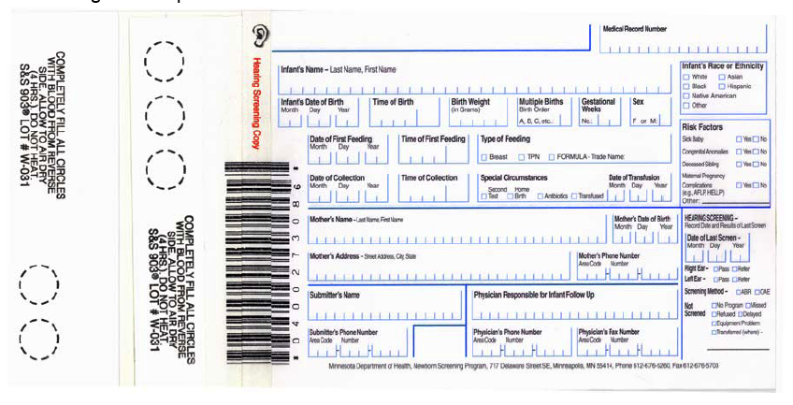
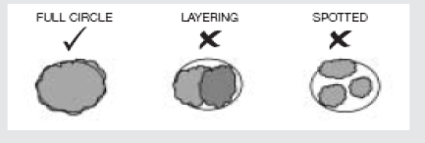
How to collect the sample?
CORD SAMPLE
Collected from the placental side of the cord
Wipe maternal blood from cord
Collect 3-5 ml blood by cutting cord between the clamp and placenta, or by pricking placental vein with sterile needle and syringe
Store at 4⁰C after appropriate labelling
Transport to lab within a day
HEEL PRICK
Air dried & transported at room temperature

Slide 16
Which test to be performed?
Primary TSH based screening
  More sensitive and specific for the diagnosis of CH
  May miss central hypothyroidism or delayed rise of TSH
Primary T4 based screening
  Can identify both primary and central hypothyroidism
  Will miss compensated (subclinical) hypothyroidism
  Higher false positive results
Primary TSH based screening adopted by most centres worldwide and is recommended for India

Slide 17
Second sample for screening
In some situations, initial screen may miss CH, hence a second sample between 2-4 weeks is suggested
Indications
  Preterm
  IUGR
  Sick neonates
  Twin/multiple births
  Down syndrome
  First sample taken after transfusion
In an overburdened public health system, not missing an infant with severe primary CH is the priority

Slide 18
Interpretation of screening and confirmatory sample

Slide 19
Whole blood vs. serum units of TSH
TSH from a filter paper can be reported either in whole blood units or serum units
It is recommended to use serum units to ensure uniformity of reporting
TSH in serum units = (TSH in whole blood units) X 2.2
For example:
If TSH in whole blood units has been reported to be 10 mIU/L
Equivalent TSH in serum units = 10 X 2.2 = 22 mIU/L

Slide 20
Interpretation of screening results
Heel prick OR cord blood TSH
All TSH values in serum units
Recall if TSH ≥ 20
(≥ 34 for samples taken between 24-48 hr)
TSH > 40
TSH 20-40
Repeat screening in 2nd week of life
Repeat screening
not feasible
TSH >20 for <2 week age OR
TSH > 10 for >2 week age
Physical examination and confirmatory venous sample for T4 and TSH
Start immediate treatment pending results if screening TSH > 80

Slide 21
Interpretation of confirmatory sample
TSH
Treatment initiation as soon as possible, and must before 2 weeks of life
High
Normal
Hypothyroidism
(high TSH , Low T4)
Hypothyroxinemia of Prematurity
Sick euthyroid syndrome
Delayed rise of TSH
TBG deficiency
Central hypothyroid
Discussed in next slide
TSH > 20 in first 2 weeks, and > 10 beyond 2 weeks, is high
Low
T4
Borderline high TSH with normal T4
Normal
Normal
Discussed in next slide
Total T4 <10 µg/dL and FT4 < 1.17 ng/dL is low
Taking confirmatory sample is mandatory for all suspected CH babies

Slide 22
Borderline thyroid function
Borderline high TSH with normal T4
DDs: Transient/permanent primary CH, delayed maturation of HP axis, thyroid hormone resistance, Down syndrome, pseudohypoparathyroidism
Low T4 with normal TSH
R/o hypothyroxinemia of prematurity/sick euthyroid syndrome (clinically), TBG deficiency (low TBG levels)
Repeat test after 2 weeks
Treat if consistent with central hypothyroidism (rule out other pituitary hormone deficiencies)
In other cases repeat T4, TSH after 2-4 weeks and treat if persistently low T4 / delayed rise of TSH
Treat if TSH > 10 beyond 3 weeks of life even with normal T4
Pediatric endocrine referral and imaging useful in such cases

Slide 23
Evaluation of primary CH

Slide 24
Evaluation of primary CH
History & Physical examination
  Consanguinity, perinatal history, maternal autoimmune thyroid disease, iodine exposure
  Dysmorphism
  Associated anomalies (cleft palate, congenital heart disease, hypotonia)
Imaging to identify the etiology of CH
Hearing screen
AP radiograph of knee showing absent lower femoral epiphysis suggests severe CH & correlates with later intelligence and motor scores

Slide 25
Etiology
Permanent
Thyroid agenesis/dysgenesis
Ectopic thyroid
Transient
Maternal thyroid antibodies
Iodine deficiency
Other less common
Central hypothyroidism
Thyroid dyshormonogenesis
Maternal antithyroid medications
Iodine exposure
Resistance to thyroid hormone

Slide 26
Thyroid imaging
Why?
Identification of etiology of CH (athyreosis needs relatively higher dose)
What ?
Thyroid ultrasound
When?
USG can be done anytime before or after treatment
Scan should be done before starting treatment or within 7 days
Helps in counselling family
Thyroid nuclear imaging (usually Tc-99 thyroid scan)
If no resource constraints, do both scan and USG
Can avoid interrupting therapy at 3 yr of age if permanent etiology confirmed
Treatment should be not delayed for getting the imaging done!

Slide 27
Identifying etiology using thyroid imaging
Thyroid Scan
Uptake at the base of tongue
No uptake in neck or
elsewhere in body
Increased uptake
Normal uptake
USG showing enlarged thyroid
USG Thyroid
Normal gland on USG
LINGUAL/ECTOPIC
THYROID
DYSHORMONOGENSIS
Gland Not Visualized
Gland seen
TRANSIENT HYPOTHYROIDISM/DYSHORMONOGENESIS
MATERNALTHYROID ANTIBODIES /
IODINE UPTAKE DEFECTS
Perchlorate discharge/genetic studies for confirmation
THYROID AGENESIS

Slide 28
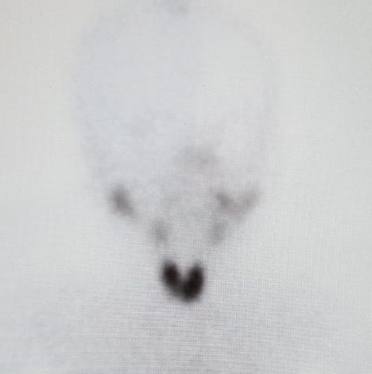
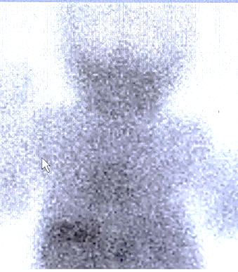
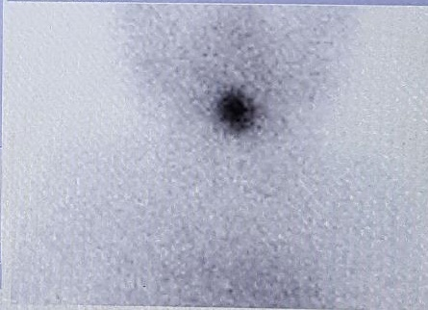
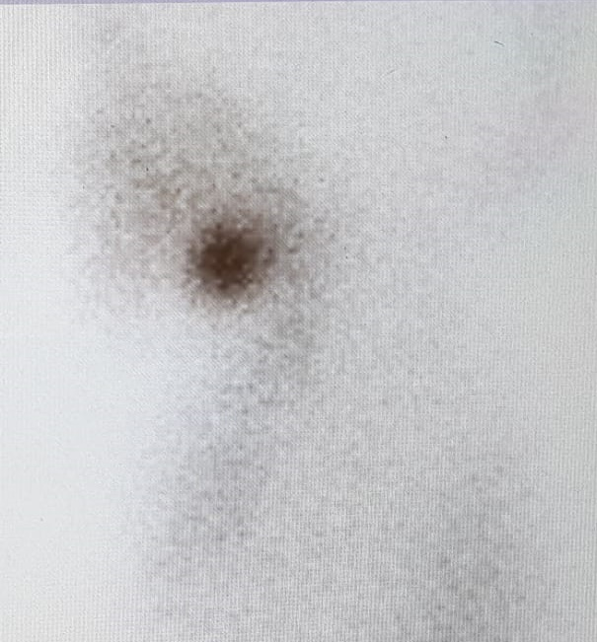
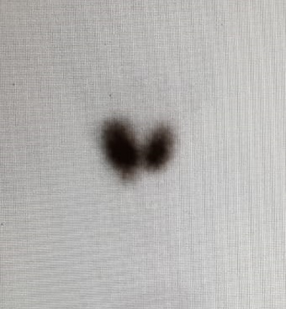
Thyroid scan
Uptake at the base of tongue In ectopic gland,
more clearly seen in the lateral view
Tc- scan showing normal
Uptake on thyroid region (eutopic gland)
Note the normal salivary gland uptake (blue arrows)
No uptake in thyroid bed
Suggest agenesis/
Blocking antibodies/
Iodine uptake defects
Goiter & increased uptake on scan suggests dyshormonogenesis, note that the salivary uptake is not seen well

Slide 29
Treatment & follow up

Slide 30
Treatment
Tab Levothyroxine 10-15 µg/kg/day as single daily dose
Severe cases (e.g. very low T4, very high TSH, athyreosis) - start with higher range of dose
Crush tablet in small quantity of breast milk till 6 mo of age and breast milk/water after 6 mo, administer directly with spoon
Do not add tablet to feeding bottle
Avoid iron/calcium/soya/vitamins within 3-4 hr of thyroxine
Counsel the family!!!
Give written information to parents
Early and adequate treatment is the key to prevent neurological damage
Available on www.ispae.org.in

Slide 31
Further biochemical follow up
Repeat T4/ FT4 (either of the two) at 2 weeks and T4/ FT4 & TSH at 4 weeks
(sampling before or at least 4 hr after the thyroxine dose)
Target T4 in upper half of reference range by 2 weeks and TSH in lower half of normal range by 4 weeks of treatment
Further Biochemical follow up at regular intervals
Every 2 monthly till 6 months of age
Every 3 montly between 6 months to 3 years of age
Every 3-6 monthly after 3 years of age till end of growth, 6-12 monthly thereafter
4 weeks after changing thyroxine dose
More frequent follow-up may be necessary if frequent fluctuations of T4 and TSH

Slide 32
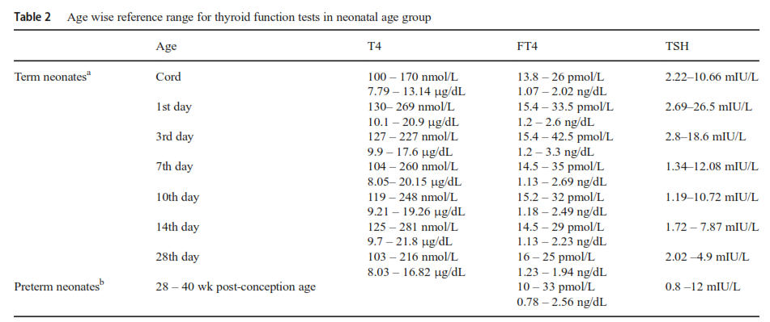
Reference range - neonatal period
ª Mutlu M et al, J Matern Fetal Neonatal Med. 2012;25:120-4.
^{b} Clark SJ et al, J Perinatol. 2001;21:531-6.

Slide 33
Reference range - post neonatal period
Lem AJ et al, J Clin Endocrinol Metab. 2012;97:3170-8

Slide 34
Follow up
T4 & TSH
Maintain T4 in upper half of normal range
Maintain TSH in lower half of normal range
Growth & puberty
Plot height and weight regularly on a growth chart
Development
Developmental assessment at each follow up
Head circumference
Tanner staging for older children and adolescents

Slide 35
High TSH in follow up
Check compliance to thyroxine
Enquire the technique of administration
Ask for h/o co-administration of substances which can impair absorption of thyroxine
High TSH in presence of high normal or high T4
  Sampling for T4 within 4 hours of medication
  Chronic poor adherence followed by making up multiple doses before sampling
  Pituitary level resistance to T4 action (try and obtain T4 and TSH levels as close to normal as possible without avoiding extreme elevation of both in this scenario)

Slide 36
Rechecking for permanency of CH
In suspected transient hypothyroidism, recheck for permanency of CH at 3 yr of age
Stop thyroxine for 4 weeks and recheck T4, TSH
  If TSH > 10 – do imaging if not done earlier, and restart treatment
  TSH 5-10 and normal T4 – refer to pediatric endocrinologist
  TSH < 5 , T4 in normal range- transient CH- important to continue clinical follow up and repeat T4, TSH at slightest suspicion of recurrence of hypothyroidism
If etiological confirmation not desired, stepwise thyroxine dose reduction can be done for checking continuing need of therapy
Re-evaluation not required if
    Proven condition with permanent hypothyroidism (e.g. lingual gland, agenesis confirmed by scan as well as USG)
    High TSH while on treatment beyond 1½ - 2 years
Critical that the follow up test after stopping thyroxine obtained in timely manner and there is no loss to follow-up

Slide 37
Conclusions

Slide 38
Conclusions
Every newborn must be screened for CH
Screening can be done by cord blood, or postnatal heel prick sample taken at 48-72 hr (not later than 5 days) of life (peripheral venous sample is acceptable if filter paper sampling is not feasible)
Infants with screening TSH > 20 mIU/L of serum units (> 34 if sample taken between 24-48 hr) should be recalled for confirmatory sample
Second screening may be needed in special high risk population (preterm, SGA, sick newborn, twins, Down syndrome etc.) and should be done at 2-4 weeks of age

Slide 39
Conclusions
Venous TSH > 20 in first 2 weeks and > 10 beyond 2 weeks of age, with low T4 ( < 10 µg/dL or FT4< 1.17 ng/dL) suggests primary CH
Thyroid imaging is desirable in primary CH but should not lead to delay in treatment
Treatment is given with levothyroxine tablet at 10-15 µg/kg as single daily dose
Education of family on technique of thyroxine administration, importance of follow up and compliance

Slide 40
Conclusions
Frequent clinical and biochemical evaluation to keep T4/ FT4 in upper half of age appropriate reference range and TSH in lower half of normal range
Regular growth and developmental monitoring and hearing evaluation is needed
In suspected transient CH, re-evaluation for permanency can be attempted at 3 years of age

Slide 41
Acknowledgements
Module created by
Ganesh Jevalikar, Riaz I, M Vijayakumar
Voiceover by
Ganesh Jevalikar (for part 1) , Riaz I (for part 2)
ISPAE guidelines writing committee
Meena Desai, Rajni Sharma, Riaz I, Siddhnath Sudhanshu, Ruchi Parikh, Vijayalakshmi Bhatia
ISPAE guidelines editorial committee
Girish Gupta, Ganesh Jevalikar, Sarah Mathai, PSN Menon, P Raghupathy, Sudha Rao, Anju Seth, Anna Simon, M Vijayakumar, Anju Virmani

Slide 42
Thank you!
www.ispae.org.in

Slide 43
Newborn Screening for Congenital Hypothyroidism – II
(case scenarios)
Indian Society for Pediatric and Adolescent Endocrinology (ISPAE) Module

Slide 44
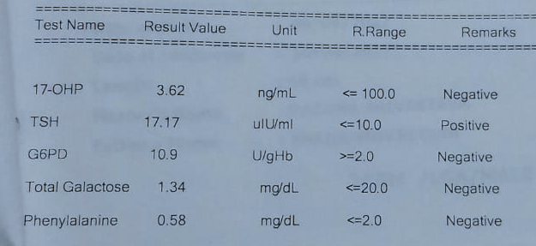
Case 1
Full term, 3 kg, healthy male newborn
Neonatal screen done by heel prick on day 3 of life
Always confirm reporting units of filter paper report as whole blood or serum units
What is the interpretation?
Should this infant be recalled for repeat screen/confirmatory sample?

Slide 45
Case 1
Filter paper samples are often reported in whole blood units of TSH
TSH in serum units = (TSH in whole blood units) X 2.2
In this sample, the reporting units were whole blood units
So in terms of serum units this is equal to 17 X 2.2 = 37.5 mIU/L (more than the cut-off of 20 mIU/L for recall)
So this infant must be recalled for confirmatory serum sample

Slide 46
Case 2
Full term, 2.7 kg, female newborn
Cord blood TSH 120 mIU/L (serum units)
What should be the next course of action?

Slide 47
Interpretation of screening results
Heel prick OR cord blood TSH
Recall if TSH ≥ 20
(≥ 34 for samples taken between 24- 48 hr)
TSH > 40
Physical examination and confirmatory venous sample for T4 and TSH
Start immediate treatment pending results if screening TSH > 80

Slide 48
Case 2: follow up
TSH > 20 should be recalled for confirmatory sample
A venous sample should be collected for T4 and TSH (since TSH is > 40)
Physical examination
Treatment should be started pending the results of the venous sample in this case since screening TSH >80

Slide 49
Case 2: Confirmatory sample
Physical examination normal
Venous sample results- day 3 of life
TSH – 500 mIU/L
Free T4 – 0.15 ng/dL
TSH > 20 is high
FT4 < 1.1 ng/dL is low
Low T4, High TSH
Primary CH
How should this baby be evaluated ?

Slide 50
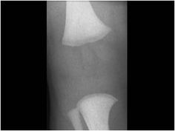
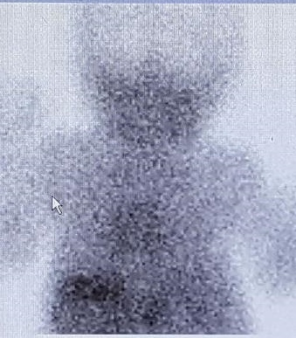
Evaluation
Physical examination
X ray knee AP view
Hearing screen
Thyroid scan should be done if possible
Treatment should not be delayed if scan can not be done immediately
Both thyroid scan and USG are useful in identifying etiology
Absent femoral epiphysis suggests severity of CH
Absent Tc uptake in thyroid bed suggests agenesis or defective iodine uptake
USG further confirmed absent gland in this case

Slide 51
Case 2 : Treatment
Tab L-Thyroxine 37.5 µg/d (14 µg/kg/d)
(dose is 10-15 µg/kg/d)
Administration technique explained
Written handout given
Importance of follow up and compliance discussed
Asked to follow up after 2 weeks with T4 and TSH
Available on www.ispae.org.in

Slide 52
Follow up
Lab report after 2 weeks of taking thyroxine
FT4 – 2.23 ng/dL ( N range in lab 0.6- 1.8 )
TSH – 28 mIU/L
Does this mean that we should reduce dose since T4 is high?
Also what about the high TSH?
Labs often give reference ranges for adults, we should use age appropriate reference range
Here age specific range for FT4 is 0.9- 2.6 ng/dL, so the FT4 is in desired range and same dose should be continued
2 week sample is to ensure normal T4/ FT4; the very high TSH at baseline may take time to settle

Slide 53
Further biochemical follow up
Repeat T4/FT4 at 2 weeks and T4/FT4 & TSH at 4 weeks
(sampling before or at least 4 hr after the thyroxine dose)
Target T4 in upper half of reference range by 2 weeks and TSH in lower half of normal range by 4 weeks of treatment
Further Biochemical follow up at regular intervals
Every 2 monthly till 6 months of age
Every 3 montly between 6 months to 3 years of age
Every 3-6 monthly after 3 years of age till end of growth, 6-12 monthly thereafter
4 weeks after changing thyroxine dose
Target T4 in upper half and TSH in lower half of normal reference range
Use age appropriate reference ranges

Slide 54
Follow up after 6 months
Growth and milestones normal
On 37.5 µg/day of LT4 dose
FT4: 1.8 ng/dL (Normal 1.1- 2.1)
TSH : 9 mIU/L (Normal 0.5- 5.5)
This baby has higher TSH than desired
How should we approach this in follow up?

Slide 55
High TSH in follow up
Check compliance to thyroxine
Enquire the technique of administration
Ask for h/o co-administration of substances which can impair absorption of thyroxine
High TSH in presence of high normal or high T4
  Sampling for T4 within 4 hours of medication
  Chronic poor adherence followed by making up multiple doses before sampling
  Pituitary level resistance to T4 action (try and obtain T4 and TSH levels as close to normal as possible without avoiding extreme elevation of both in this scenario)

Slide 56
Rechecking for permanency of CH
Since in case 2, cause of hypothyroidism is known to be permanent, re-checking is not needed
This is also not needed if TSH was high beyond infancy, and the thyroxine dose had to be increased
In other cases rechecking for permanency can be done at 3 years of age by stopping/reducing the dose for 4-6 weeks and rechecking T4/ FT4 and TSH

Slide 57
Case 3
Term male neonate, 2.9 kg
Thyroid profile on day 3
  TSH- 30 mIU/L (serum units)
  FT4- 1.46 ng/dL (Normal 1-2.6)
What should be the next course of action?

Slide 58
Interpretation of screening results
Heel prick OR cord blood TSH
Recall if TSH ≥ 20
(≥34 for samples taken between 24- 48 hrs)
TSH 20- 40
Repeat screening in 2nd week of life
Repeat screening
Not feasible
TSH >20 for <2 week age OR
TSH >10 for >2 week age
Physical examination and confirmatory venous sample for T4 and TSH

Slide 59
Follow up: case 3
Repeat venous sample on day 14
(since repeat screen was not feasible at the center)
  TSH- 18 mIU/L
  FT4- 1.6 ng/dL

Slide 60
Case 3: Borderline high TSH, normal T4
Possibilities:
Transient /permanent CH
Delayed maturation of HP axis
Thyroid hormone resistance
Down syndrome
Pseudohypoparathyroidism
Recheck TSH, T4 after 2 weeks
Normal - no treatment
Persistent borderline TSH > 10 beyond 3 weeks with normal T4
Treatment is justified at first instance for isolated high TSH, if follow up is questionable
Low T4 with borderline high TSH should be treated
Start treatment
Trial off therapy at 3 yr.

Slide 61
Case 3: Follow up
TSH repeated after 2 weeks
TSH- 7 mIU/L , normal T4
Is it normal ?
TSH concentrations are slightly higher in first 2-3 months of life (up to 9.1 mIU/L ) - Pediatrics. 2006;117:2290–303
Also decline in serial values is evident in this case (30 18 7)
Rare infants with borderline high TSH (10-20) and normal T4 can have permanent CH, hence individualized approach may be needed
Thyroid imaging and pediatric endocrine consultation are valuable in such cases

Slide 62
Case 4
Laboratory results of thyroid function tests in a 7 day old preterm neonate
Total T4 - 4 µg/dl (Normal 6-15.9)
TSH - 2.5 mIU/L (Normal 0.9-9.1)
What is the differential diagnosis of low T4 and normal TSH ?

Slide 63
Differential diagnosis of low T4 and normal TSH
Hypothyroxinemia of prematurity
Sick euthyroid syndrome
TBG deficiency
Primary CH with delayed rise of TSH (mostly in preterm or SGA babies)
Central hypothyroidism
  Look for micropenis, midline defects, conjugated jaundice, nystagmus, hypoglycemia, polyuria

Slide 64
Approach to isolated low T4 and normal TSH
Hypothyroxinemia of prematurity and sick euthyroid syndrome usually evident clinically
Document FT4, TBG levels to rule out TBG deficiency
Further evaluation and treatment if clinically consistent with central hypothyroidism (diagnosis and treatment of other ant pituitary hormone deficiencies important)
Monitor T4 after 2-4 weeks if isolated low T4 – treat if
  Delayed rise of TSH > 10
  Persistently low T4
  Recheck for permanency of CH at 3 year of age in such cases
No benefit of treating hypothyroxinaemia of prematurity

Slide 65
Case 4
Full term, 2.7 kg, male newborn with Down syndrome
Cord blood TSH is 15 mIU/L
According to ISPAE guidelines this is normal
What should be the next course of action?

Slide 66
Second screening
Preterm
Low birth weight
Sick babies admitted to NICU
Multiple birth (especially monozygotic twins)
First screen taken after transfusion/ exchange transfusion
Down syndrome

Slide 67
Case 4 follow up
Repeat screening done at 2 weeks
TSH - 36 mIU/L (serum units)
Confirmatory sample – TSH - 28.5 mIU/L, FT4 - 1.54 ng/dL
Tc Scan – Normal uptake of thyroid gland seen in the neck
Started on treatment with thyroxine

Slide 68
Subclinical hypothyroidism in Down syndrome
Incidence of CH detected higher in Down syndrome
Combination of high TSH and normal T4 is common (7-40%)
A second screen between 2-4 weeks is indicated
Guidelines for treatment are not different compared to children without Down syndrome
Persistent mild elevation of TSH between 6-10 is often treated in Down syndrome, however no clearcut consensus exists on this
Kariyawasam et al, Horm Res Pediatr 2015;83(2):126-31

Slide 69
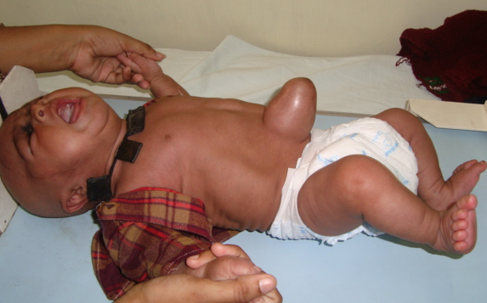
Case 5
6 month, female infant, second of a twin
Normal initial screening
Delayed milestones
TSH > 60 mIU/L
T4 low
Normal initial screen does not rule out congenital hypothyroidism
Repeat thyroid profile if clinically suspected hypothyroidism

Slide 70
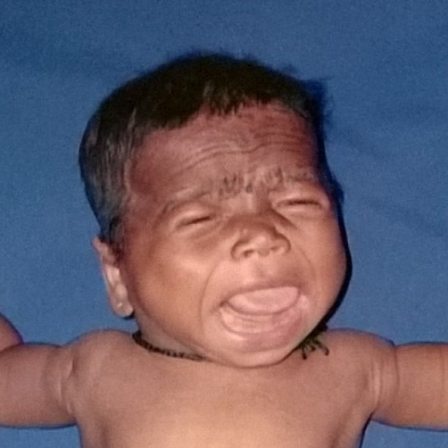
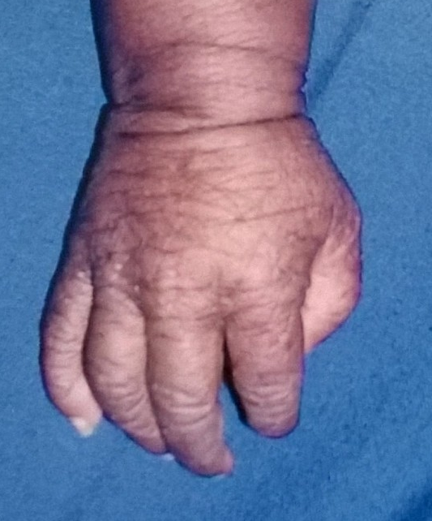
Symptoms of CH
Prolonged neonatal jaundice
Poor feeding, lethargy
Unusually “quiet” baby
Constipation
Dry, rough skin
Umbilical hernia
Delayed milestones
Delayed dentition

Slide 71
Causes of falsely normal newborn screen
About 5% cases can be missed despite screening
Methodological errors
  Failure of sample collection
  Unsatisfactory samples
  Misinterpretation of samples
  Unsatisfactory recalls
False negative results
  Preterm
  Very low birth weight
  Critically ill newborn
  Post transfusion sample
  Monozygotic twins
Some cases of ectopic thyroid or dyshormonogenesis can be euthyroid in neonatal period and may manifest later

Slide 72
Conclusions
Filter paper samples are reported in whole blood units and should be interpreted accordingly
The main purpose of newborn screen is to pick up primary CH causing risk of intellectual disability
Prompt evaluation, early and adequate treatment and education are the keys to success in CH management

Slide 73
Conclusions
For borderline high TSH (20-40) on screening, the choice of second filter paper screen for TSH vs. venous sample for T4, TSH may be decided based on the clinical setting
In case of borderline high TSH with normal T4, follow up testing can be done after 2 weeks of age, and treatment started if TSH is > 10 on follow up
Second screening is valuable to not miss babies at risk of delayed TSH elevation
If symptoms of CH are seen in babies who have had normal screen, the lab testing should be repeated

Slide 74
Acknowledgements
Module created by
Ganesh Jevalikar, Riaz I, M Vijayakumar
Voiceover by
Ganesh Jevalikar (for part 1) , Riaz I (for part 2)
ISPAE guidelines writing committee
Meena Desai, Rajni Sharma, Riaz I, Siddhnath Sudhanshu, Ruchi Parikh, Vijayalakshmi Bhatia
ISPAE guidelines editorial committee
Girish Gupta, Ganesh Jevalikar, Sarah Mathai, PSN Menon, P Raghupathy, Sudha Rao, Anju Seth, Anna Simon, M Vijayakumar, Anju Virmani

Slide 75
Thank you!
www.ispae.org.in

