Slide 1
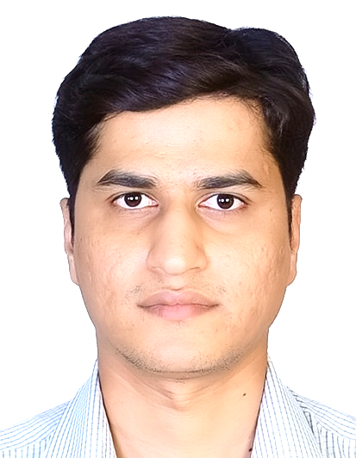
Dr. Nikhil Lohiya (DNB, FCPE, FCRPE, Fellowship Ped Endo- Alder Hey Hospital, UK)
Consultant Pediatric & Adolescent Endocrinologist at Silver Lining Pediatric Super Specialty Center, Nagpur
Founder & Director Silver Lining Pediatric Foundation, Nagpur
Adjunct Faculty, Pediatric Endocrinology, DMMC & Shalinitai Hospital, Wanadongri, Nagpur
Fellowship in Pediatric Endocrinology at Alder Hey Children Hospital, Liverpool, United Kingdom
Trained (3 yrs) in Paediatric Endocrinology (Bharati Vidyapeeth HCJMRI & Jehangir Hospital, Pune)
Graduate from APPES School, ISPAE PET School & ESPE Summer School (Ped Endocrine schools)
Reviewer- Frontiers in Endocrinology, Indian Pediatrics, Journal of Pediatric Endocrinology & metabolism, International Journal of Diabetes & Endocrinology & Indian Journal of Pediatrics.
Editor CAPE News 2025-26- Official Newsletter of ISPAE, Member Editorial Board- CAPE News 2019-2023
46 Publications in peer reviewed indexed national & international journals
75 research presentations at various national & international conferences
14 chapters & manuscripts in subject of Pediatric Endocrinology
7 awards at various research conferences including a gold medal (KAK Award 2016)
Areas of interest- Growth, Puberty, Obesity, Diabetes, Metabolic Bone disorders, DSD, neonatal endocrinology

